Slide 1
Chapter 6 section 2
Changes in market equilibrium

Slide 2
Things to remember!!
Excess demand will lead firms to raise prices.
Higher prices leads the quantity supplies to rise and quantity demanded to fall till they are equal
Excess supply will force firms to cut prices
Falling prices cause quantity demanded to rise and quantity supplied to fall until equal
Changes above are changes ALONG demand or supply curve (PRICE)
IF the market starts at equilibrium 2 factors can push the market to disequilibrium
Shift in the ENTIRE demand curve
Shift in the ENTIRE supply curve
5. 3 factors can shift supply curve: improved tech; gov’t taxes and subsidies; change in $ of inputs

Slide 3
Moving toward Equilibrium
Equilibrium is a moving target.
It changes as the market conditions change
Manufacturers and retail sellers are CONSTANTLY searching for a new equilibrium as technology and methods of production change
Consumers recognize this “searching” by frequent price changes, sales, and rebates
Notes:
Read about digital cameras on page 142-143

Slide 4
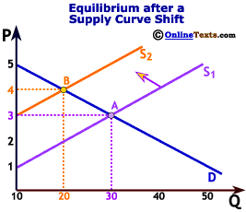

Slide 5
II. Shifts in Demand
Shortage: situation in which quantity demanded is greater than quantity supplied
Search costs: financial and opportunity costs consumers pay in searching for a good or service
Surplus: quantity supplied is greater than the quantity demanded
Equilibrium is the price that “clears the market” by leaving nether a surplus or shortage
Notes:
Read page 146: fall in demand
When demand increases both eq price and quantity also increase
When demand falls the demand curve shifts left...

Slide 6
E. When demand falls the demand curve shifts left
Suppliers respond by cutting prices on their inventory
So price and quantity sold slide down the supply curve to a new equilibrium point

