Slide 1
Chapter 6 sec 1
Changes in Market Equilibrium

Slide 2
I. Balancing the Market
A. Defining Equilibrium
1. Equilibrium: point of balance between price and quantity
Point where the supply and demand come together at the same price
2. Equilibrium occurs only at one price and one quantity
This means there is enough supply and producers will have enough people buying their products

Slide 3
Things to Remember
-Demand schedule shows how much consumers are willing to buy at various prices
-Supply schedule shows how much sellers are willing to sell at various prices

Slide 4
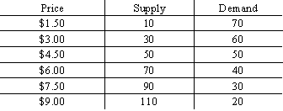

Slide 5
B. Graphing Equilibrium
1. Combine the demand curve and the supply curve into one graph
2. Equilibrium point is where the two curves cross

Slide 6
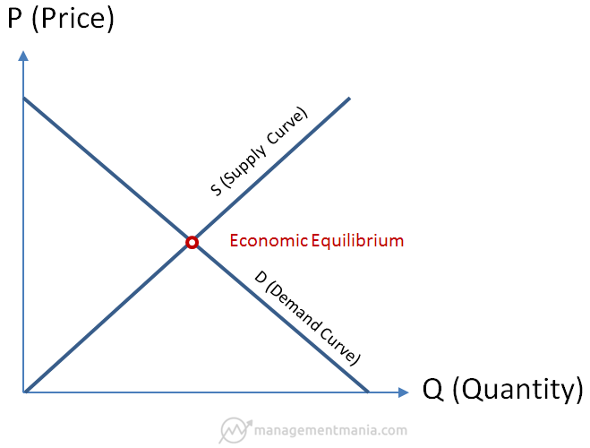

Slide 7
Things to remember part II
-Equilibrium is the point of balance b/w price and quantity QS=QD at a specific price
-At equilibrium both consumers and suppliers are HAPPY
-Equilibrium price is the price toward which the invisible hand drives the price

Slide 8
II. Disequilibrium
A. Excess Demand: occurs when quantity demanded is more than quantity supplied
This is a shortage
Suppliers will keep raising prices
B. Excess Supply: Occurs when quantity supplied exceeds quantity demanded
This is a surplus
C. Disequilibrium: any price or quantity not at equilibrium; quantity supplied is not equal to quantity demanded
Notes:
Actual price in a market is below the equilibrium price
2. Low price encourages buyers and discourages sellers
3. Leads to long lines and stores running out

Slide 10
III. Price Ceilings
A. Price Ceiling: maximum price set by law that sellers can charge for a good or service
1. Placed on goods considered essential and may become too pricey for some to buy
Rent Control
Allows people to live in an area they might not have normally been able to afford

Slide 11
B. Costs of a price ceiling
1. Some people still go without
Ceilings are meant to help the ones who are in the most need
2. Leads to bribery, discrimination by landlords, waiting lists, luck or inheritance

Slide 12
IV. Price Floors
A. Price Floors: minimum price set by the government that must be paid for a good or service
B. Minimum Wage: the minimum price that an employer can pay a worker for an hour of labor
1. States can set theirs higher
2. Full time work at min. wage will not earn enough money to keep you out of poverty
3. If min. wage is too high business won’t be able to higher as many workers

Slide 13
C. Price Support in Agriculture
1. Price control is set for farm commodities
2. Provide emergency assistance to farmers

